Slide 1




Quality Assurance of International Academic Mobility - experience form ERASMUS Mundus CASIA and TIMUR Partnership projects
Central Asia Forum on Quality Assurance
Almaty, 8 December 2017
Ewa Wietsma - Wageningen University, Department of Environmental Science, NL

Slide 2
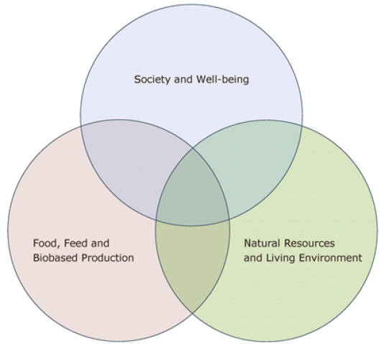
Wageningen University and Research three core areas
Mission : To explore the potential of nature to improve the quality of life.
WUR ranking in QS World University Rankings 2017-2018 Agriculture and Forestry 1
WUR ranking in QS World University Rankings 2017-2018 Environmental Sciences 6
WUR ranking in National Taiwan University Ranking, World Universities 2016-2017 Agriculture 1 (4 years running)
WUR ranking in Times Higher Education World University Rankings 2016-2017 65
WUR ranking in Academic Ranking of World Universities 2016 Life & Agriculture Sciences 36
WUR ranking in Keuzegids in full time university education 2017 1(12 years running)

Slide 3

CASIA I – 90 scholarships
CASIA II – 96 scholarships
CASIA III – 116 scholarships
For Bsc, Msc, PhD, PostDocs, Staff
www.eu-casia.org
78 scholarships for Kazakhstan
2010 - 2017

Slide 4
TIMUR – Training of Individuals through Mobility from Uzbek Republic to EU
15.07.2013 – 31.01.2018
www.eu-timur.org
145 scholarships for Uzbekistan

Slide 5
2007 - 2017
IAMONET BSc MSc PhD PD AS Total
I 90 69 44 26 34 263
II 81 71 36 19 26 233
III 90 67 39 12 23 231
IV 88 62 51 16 26 243
V 77 60 49 26 34 246
Total 426 329 219 99 143 1216
Notes:
5

Slide 6

Type of scholarships
Undergraduates – exchange students or diploma seeking, following regular courses at EU Host university: 6-10-36 months
Master – exchange or diploma seeking, joint supervision during master thesis: 6-12-24 months
Doctorates – exchange, diploma seeking or PhD sandwich with joint supervision: 6-12-24-36 months
Post-Doctorates - individual research: 6-10 months
Academic staff – development of new curricula teaching and research methods: 1-3 months

Slide 7
EU Partners
Wageningen University, The Netherlands
Universitat fur Bodenkultur, Austria
University of Hohenheim, Germany
Czech University of Life Science , Czech Republic
Slovak University of Agriculture, Slovakia
Swedish University of Agricultural Science Sweden
Universidad de Granada Spain
Szent István Egyetem, Hungary
Politechnico di Torino, Italy
Montpellier University – SupAgro, France
Georg-August-Universität Göttingen, Germany
University Ljubliana, Slovenia
Universidad Las Palmas de Gran Canaria, Spain
Adam Mickiewicz University, Poland

Slide 8

From 2010
CASIA focus on agriculture, life sciences, trans-boundary natural resource management, climate change and environmental practices required for mitigation of consequences of the Aral Sea disaster and finding solutions for increasing competition between CA countries for water, for example, in a view of the water, agriculture and energy nexus.
TIMUR uses scholarships as a tool to create partnership which brings together the fields of education, technology, research, business and entrepreneurship, in order to produce new innovations and introduce them to Uzbekistan.

Slide 9
Bologna process
At present 43 different education systems covering 38 EU countries can be found
Higher Education is closely connected to the economic development of each country. EU countries are responsible for their own education and training systems, but the European Union helps them set joint goals and share good practices .
In June 1999 in Bologna, 31 European Ministers of Education signed joint declaration European space for higher education. The five main objectives of the declaration are:
  - adoption of common framework of readable and comparable degrees
  - the introduction of undergraduate BSc and postgraduate MSc/PhD levels
  - ECTS compatible credit systems
  - a European dimension in quality assurance
  - Promotion of the free mobility of students as well as trainees and graduates

Slide 11
Bologna Process
Supported development of several practical tools to enhance transparency in higher education. These include between the others:
The European Credit Transfer and Accumulation System (ECTS)
Course catalogue
The Diploma Supplement (with transcript of records)
Learning Agreements.

Slide 12
QA of mobility
To guarantee Quality Assurance of an International Academic mobility the special attention should be given at the several stages of the process:
at the start of mobility (selection)
during the mobility (student logging system)
At the end of mobility (graduation/recognition).

Slide 13

Start of mobility
The candidates applying for TIMUR/CASIA scholarships had to:
follow published on the website a step-by-step guide,
check the academic admission requirements of the host university,
fill in several forms and submit application package together with the required documents like copy of diplomas, passport etc.
to the selection team.

Slide 14
Selection
Undergraduate and Master
 | Home University | Host University
Strategic importance of the discipline coherent with TIMUR main domain | 15 | 15
Academic merit (GPA, motivation, ...) | 10 | 10
Diploma seeking | 5 | 5
English knowledge | 10 | 10
Other EU language knowledge | 5 | 5
Other (extracurricular activities) | 5 | 5
Subtotal | 50 | 50
Final score |  | 100

Slide 15
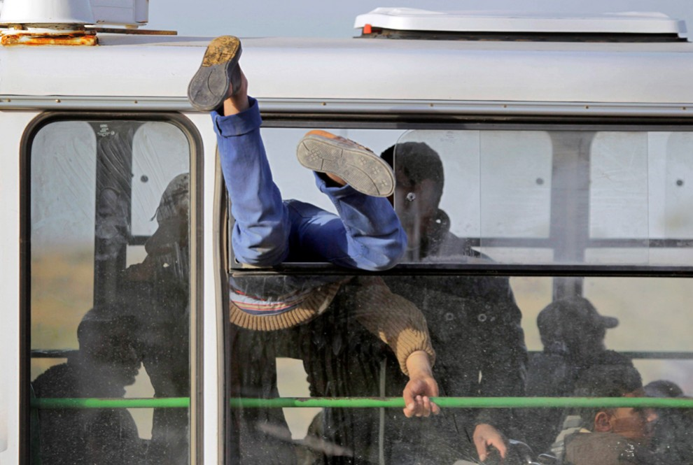
To ensure quality of applications TIMUR/CASIA partners from region organised series of seminars focused on consultations and trainings of new candidates in writing applications, intercultural communications and preparation before mobility.

Slide 16

Implementation
The biggest challenge with regard to the international student exchange is the synchronization of different education systems.
Partners should be aware about the differences (like admission requirements, language of instructions, starting date of academic year, duration of undergraduate, master and doctorates studies etc.)
Therefore the intensive information exchange was provided during project duration between project
partners.

Slide 17
Implementation
Learning Agreement
Study Plan
Courses at Host University |  |  |  |  | Courses equivalence at Home University
Subject code | Subject title | Period | Schedule | ECTS credits | Subject title | Subject code | ECTS credits

Slide 18

End of mobility
all students receive diploma supplement from EU Host University with transcript of record including marks and earned ECTS from the attended courses.
ECTS of similar courses i.e. respecting the national standards of the specialisation, included into study program.
Different content of followed courses included into program as additional/optional courses
MA diplomas with academic work load of 60 ECTS
(one year study) will be not recognized in CA

Slide 19


